Slide 1


Grievance Handling System

Slide 2
Project Overview
Digitizing organizational grievance management

Slide 3


Manual vs. Digital
Old Way
GHS Way
Paper-based records
Automated Database
Slow tracking
Instant Search
Low data security
Role-based Access

Slide 4






Core Modules
Auth
Grievance
Reports
Secure login and registration for all users.
Easy raising and tracking of concerns.
System-wide status and audit management.

Slide 5

Tech Stack
Java: Backend Logic
JDBC: Database Bridge
MySQL: Data Storage

Slide 6
System Workflow
1. Register
3. Manage
Users join
Assign Status
2. Raise
4. Resolve
File Complaint
Final Fix

Slide 7
User Permissions
Action | Admin | Manager | Employee
View All | Yes | Yes | No
Update Status | No | Yes | No
Delete Entry | Yes | No | No

Slide 8
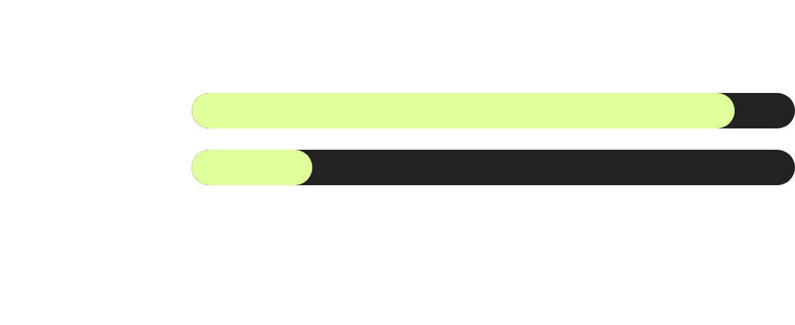
Efficiency Impact
Digital GHS reduces processing time by ~75%

Slide 9

Code Architecture
■ Database (DAO)
■ Logic (Service)
■ Display (Controller)

Slide 10
Project Results
100%
Audit Accuracy
Every ticket is tracked with User ID and Timestamp for absolute accountability.

Slide 11
Version Control
The project is hosted on GitHub, ensuring clean version history and security.
•
Clean .gitignore
•
Dummy password protection
•
Complete SQL Script included

Slide 12
Thank You

